Slide 1
IOT based clinical sensor data management

Slide 2
Mohamed Saleh Mohamed Hosny Anas Asim Mohamed Mostafa Yossif Mohamed Aziz Mostafa Sabry Mohamed Ali
Presented by:
Supervised by:
Dr. Mohamed A. Torad

Slide 3





Table of contents
1- introduction
7- AI
Smart ICU
2- objective
6- Flutter
3- UI/UX
5- IOT
4- Backend

Slide 4
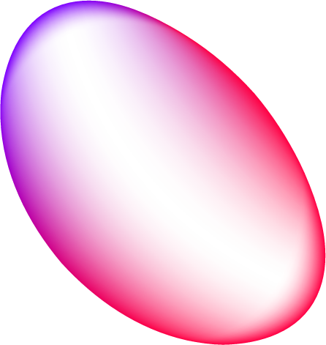
01
introduction

Slide 5
introduction
Recently, we have experienced Covid 19 disease, which was a global pandemic that led to the death of millions of people
541,102,019
6,32,000
Cases
Deaths
this is a very large number, and from here was the launch of the project

Slide 6
Health care should be focused in every home so that all ages in society, especially the elderly, are reassured because of the weakening of the heart muscle with age. In a way that is easy for any user to interact with and easy to download to different devices Medical applications for mobile devices are changing the way the world and These applications allow healthConsumers to track their health uch as heart health

Slide 7
objective
2

Slide 8
objective
1
Reduce hospital overcrowding
2
Reduce the spread of diseases and shorten the path for the patient
3
Low cost and effective
4
Simple and fast

Slide 9
UI/UX
3

Slide 10
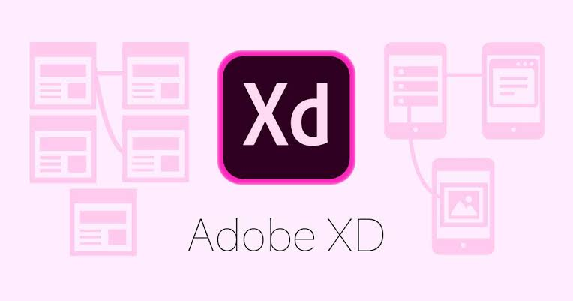

Slide 11
Backend
4

Slide 12
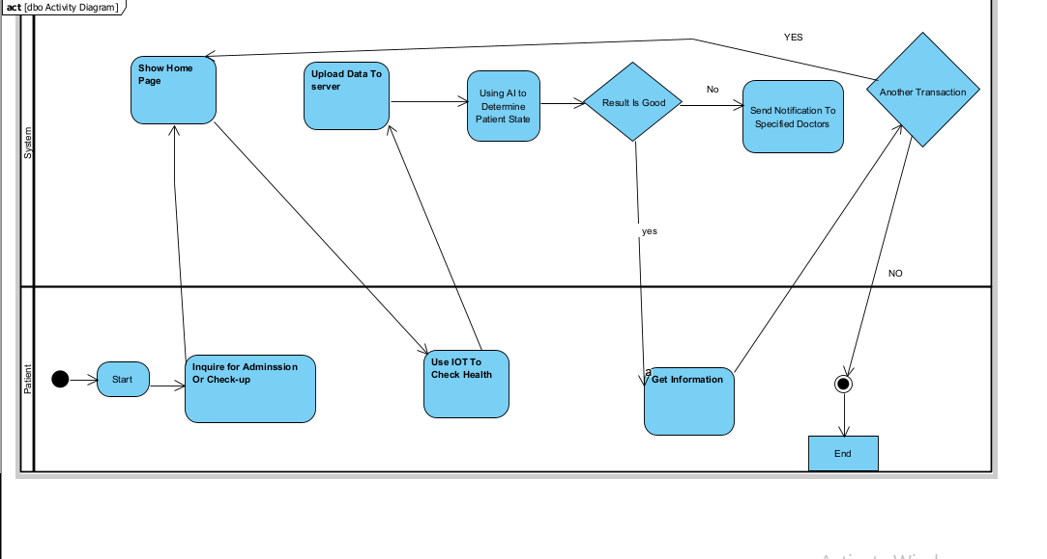
Activity diagram
Activity diagram is another important behavioral diagram in UML diagram to describe dynamic aspects of the system. Activity diagram is essentially an advanced version of flow chart that modeling the flow from one activity to another activity.
Activity diagram for patient

Slide 13
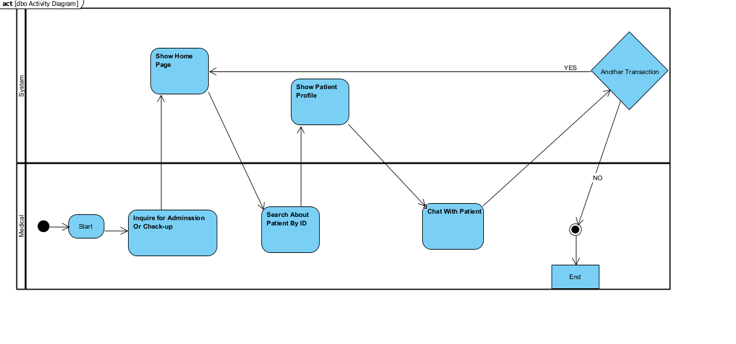
Activity diagram for Medical

Slide 14
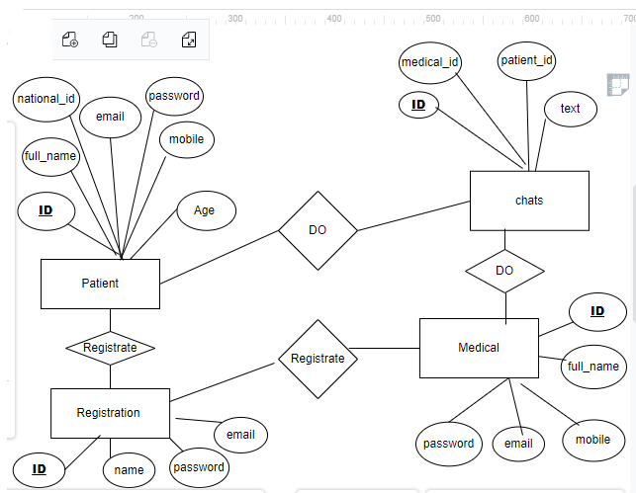
E-R Diagrams
:
Database is absolutely an integral part of software system. To fully utilize ER Diagram
in database engineering guarantee you to produce high quality database design to use
in database creation, management and maintenance. An ER model also provides a
means for communication.

Slide 15
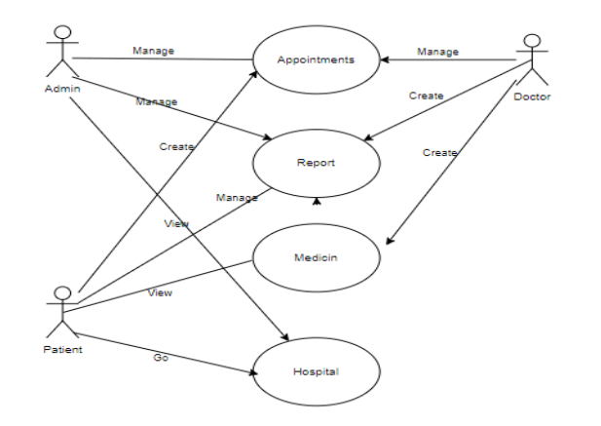
Use case diagram
A use case is a methodology used in system analysis to identify, clarify and organize system requirements. The use case is made up of a set of possible sequences of interactions between systems and users in a particular environment and related to a particular goal. The method creates a document that describes all the steps taken by a user to complete an activity

Slide 16
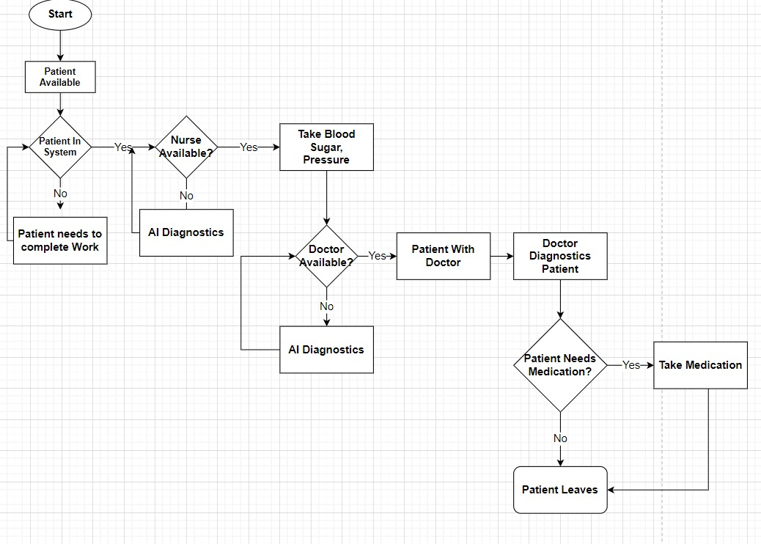
Flow Chart diagram
A flowchart is a diagram depicting a process, a system or a computer algorithm. It is a diagrammatic representation of the solution to a given problem but, more importantly, it provides a breakdown of the essential steps to solving the problem.

Slide 17
IOT and Hardware
5

Slide 18

component
2
4
5
1
3
Body Temperature Sensor
multiplexer
Node mcu Esp8266
ECG A08232 Heart Rate
Battery

Slide 19
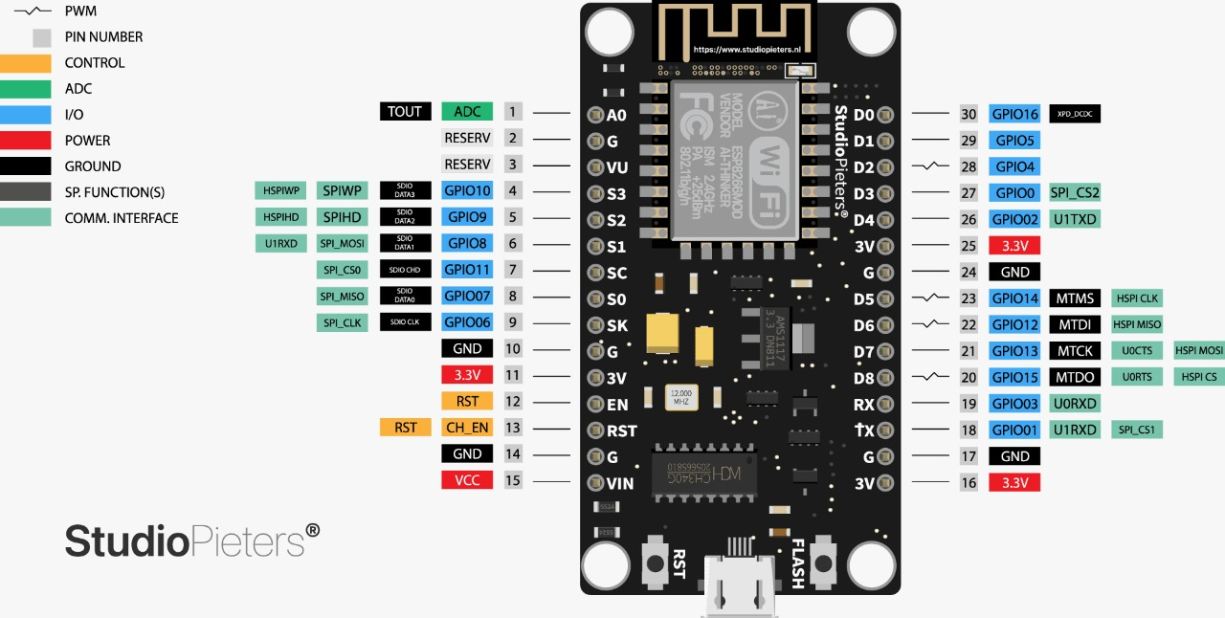
Node mcu Esp8266

Slide 20
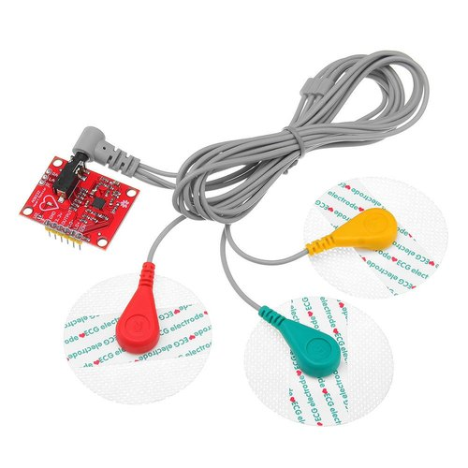
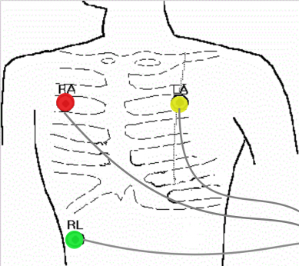
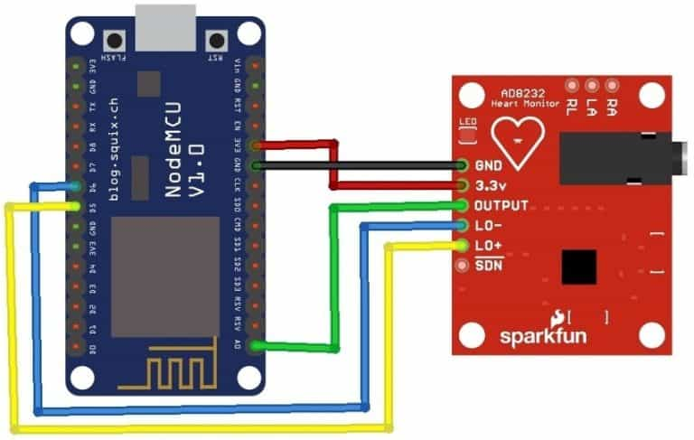
ECG Heart rate sensor

Slide 21
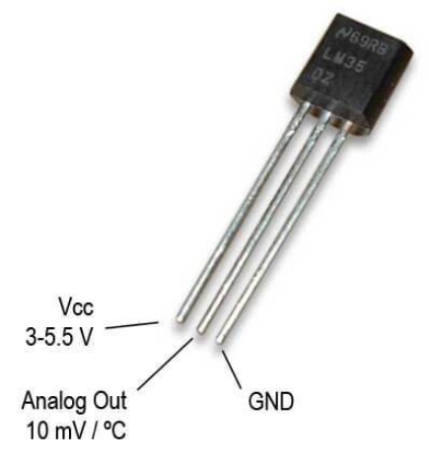
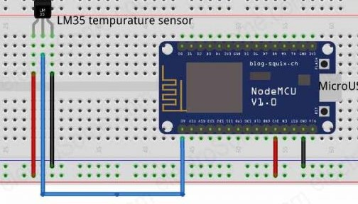
Body Temperature Sensor

Slide 22
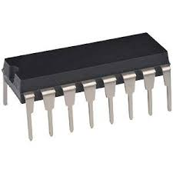
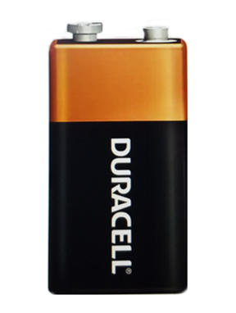
multiplexer
Battery

Slide 23
Problem definition
1
Node mcu has 1 analog
2
Node mcu has low amps
3
The battery voltage is high on the sensor

Slide 24
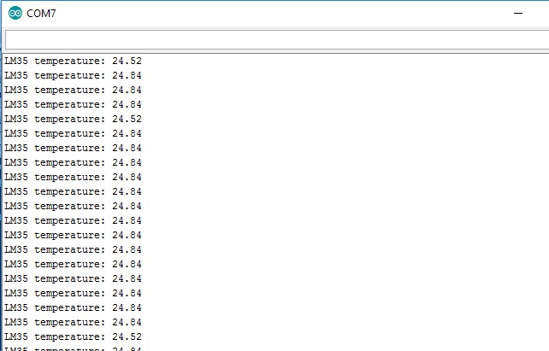
result of tempreture

Slide 25
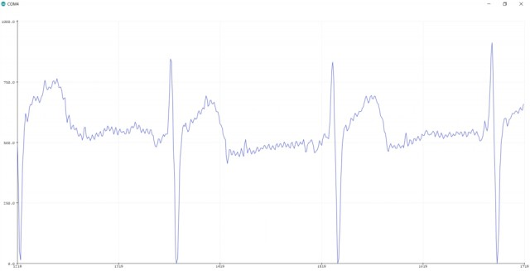
result of ECG
The ECG waveform can be seen below as a visualiations effect on Serial Monitor

Slide 26
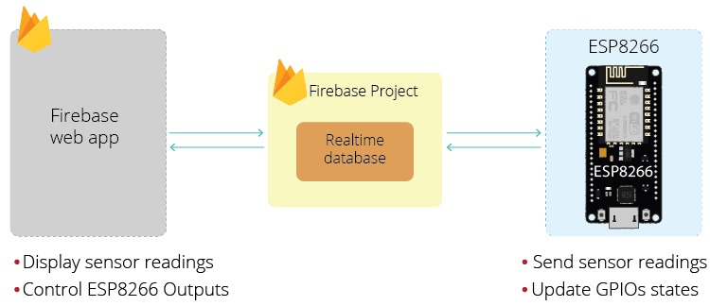

Slide 27
Flutter
6

Slide 28
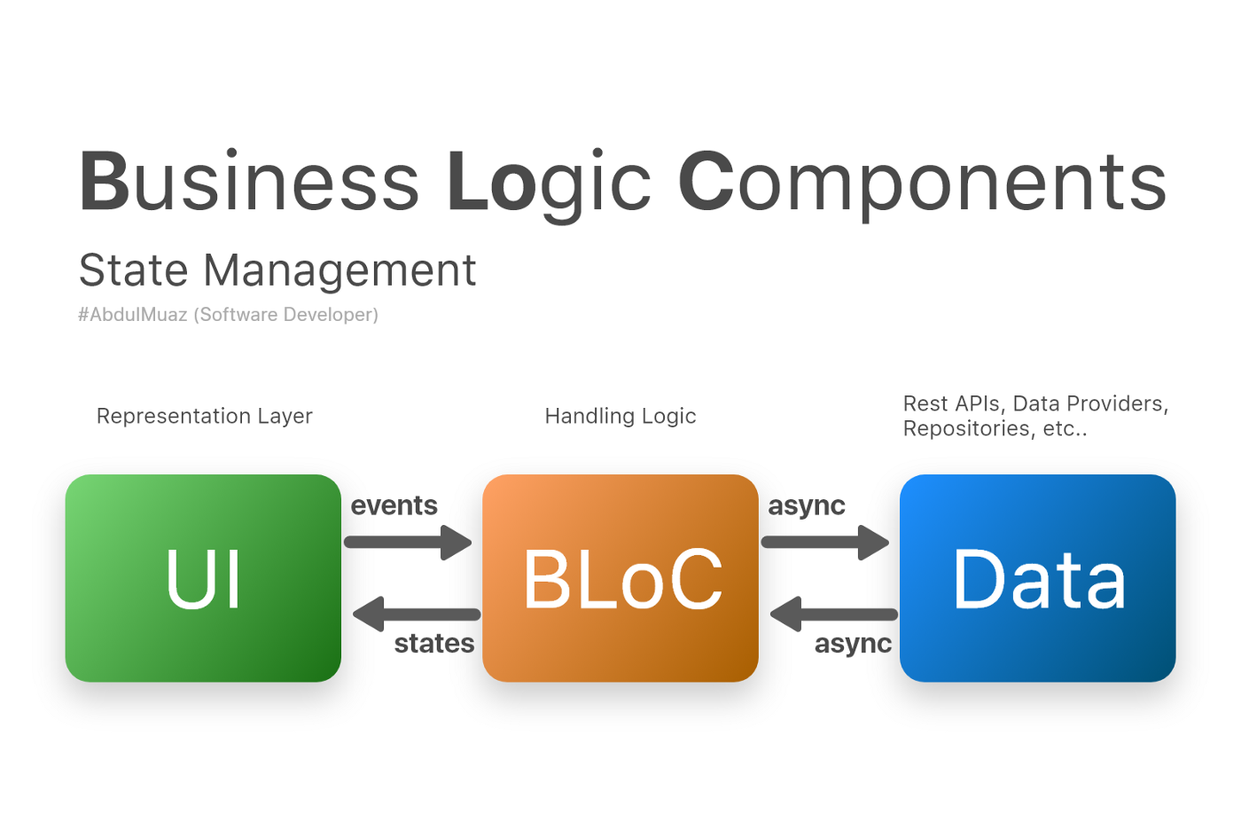
State Management Flutter
Provider => State Management
Get x => Architecture pattern
Bloc=>Design pattern, State Management , Architecture pattern

Slide 29
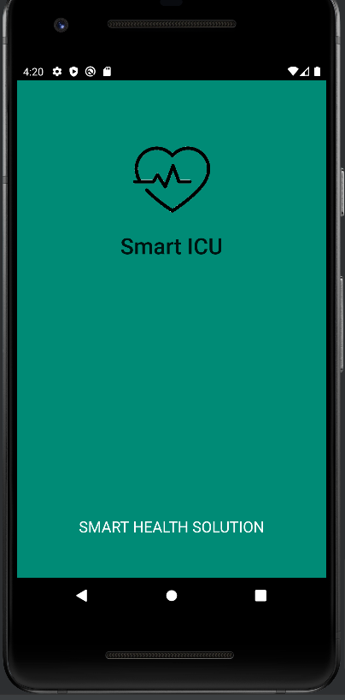
Pros of Flutter app development
It is supervised by Google, which ensures that you improve broadcasting in the vicinity.
1
2
The cost of a program created with flutter is much lower than other tools and programming languages.
which ensures that you have an application that is compatible with all screen sizes and systems.
3

Slide 30
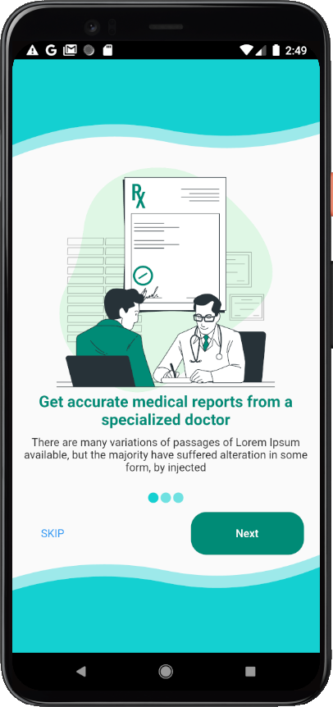
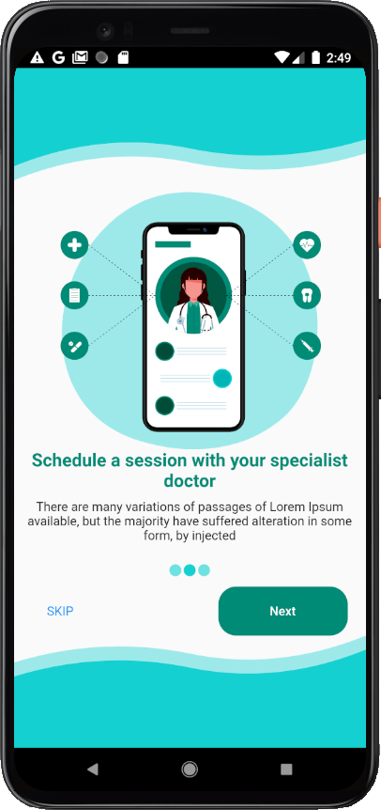
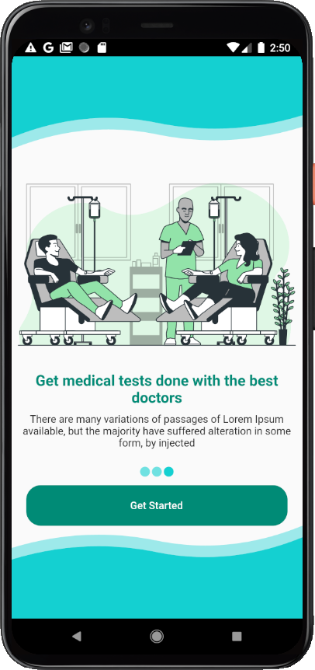
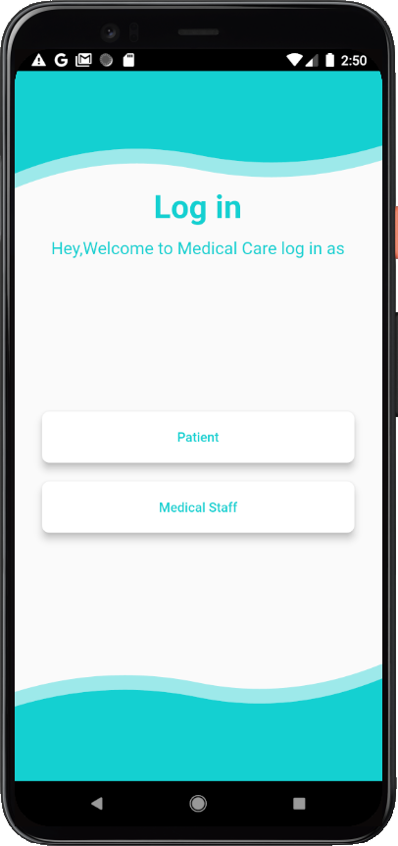

Slide 31
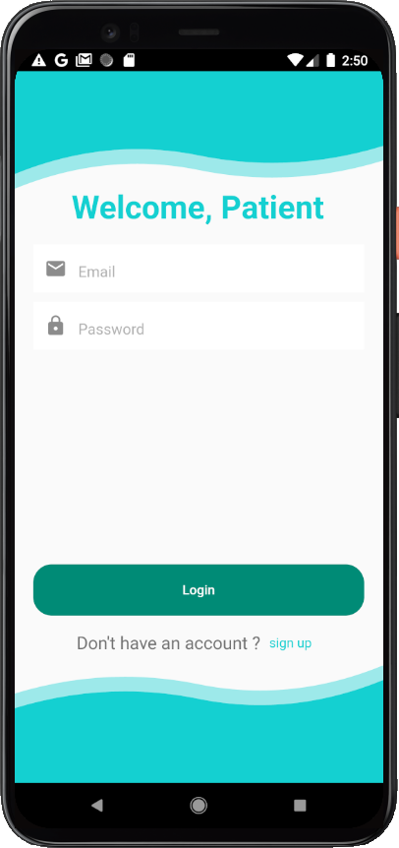
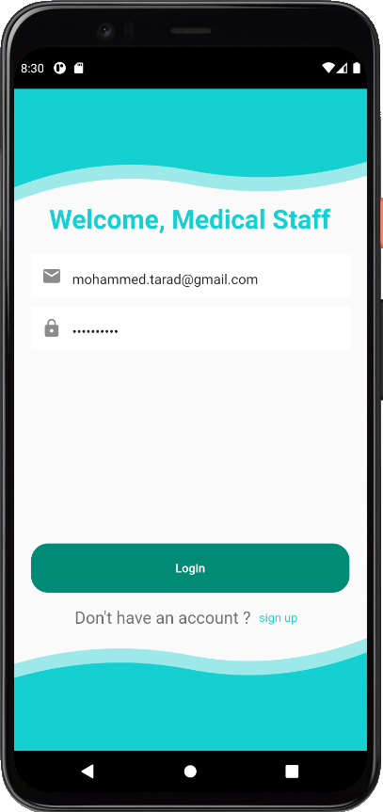
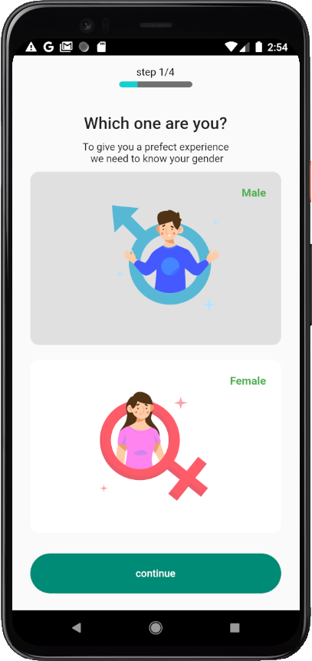
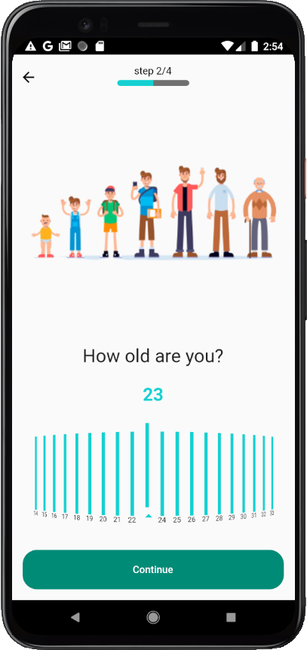

Slide 32
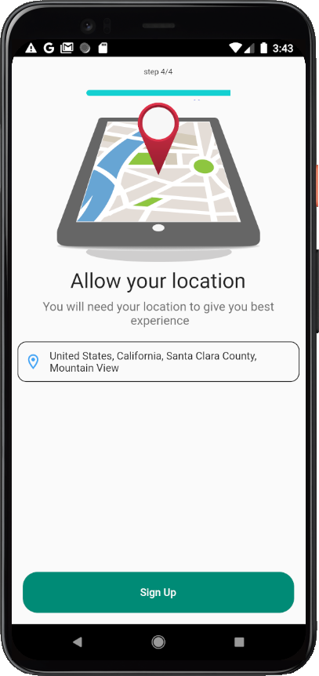
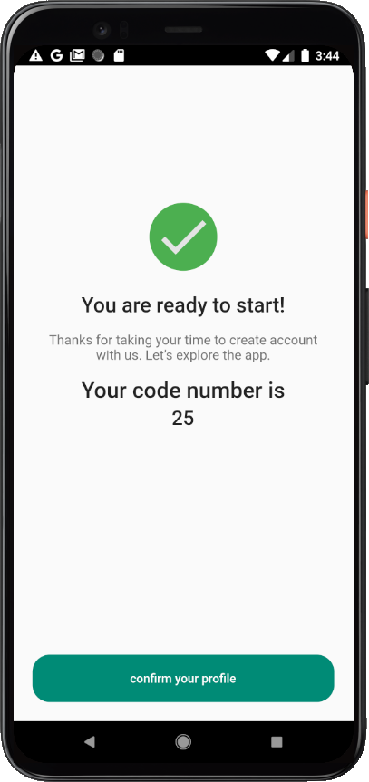
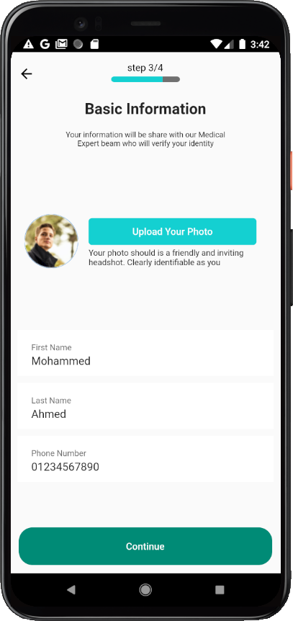
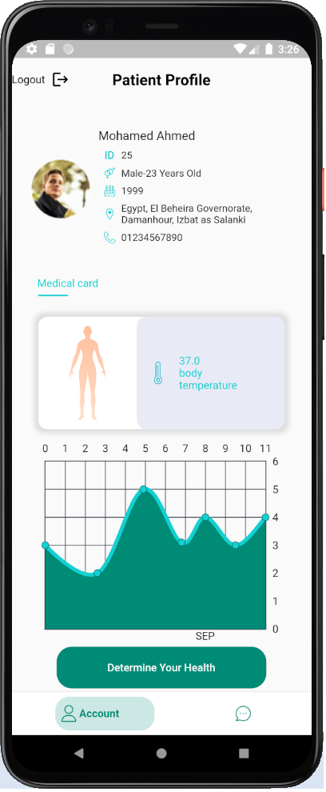

Slide 33
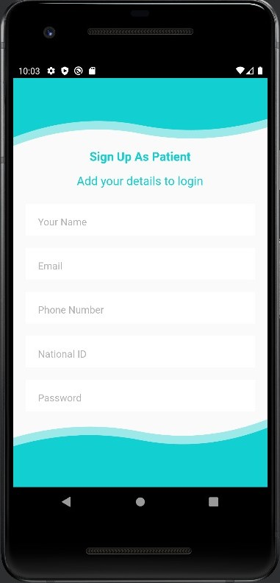
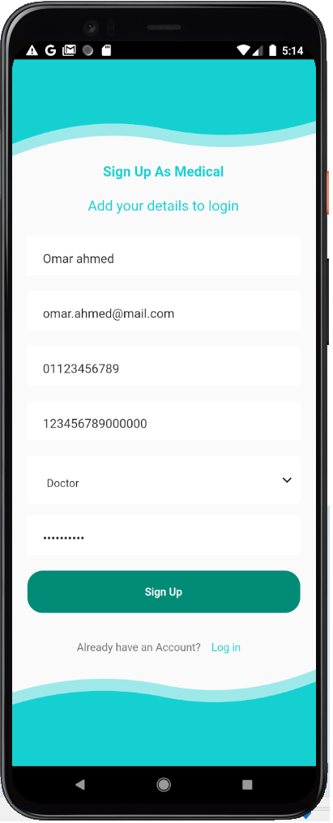
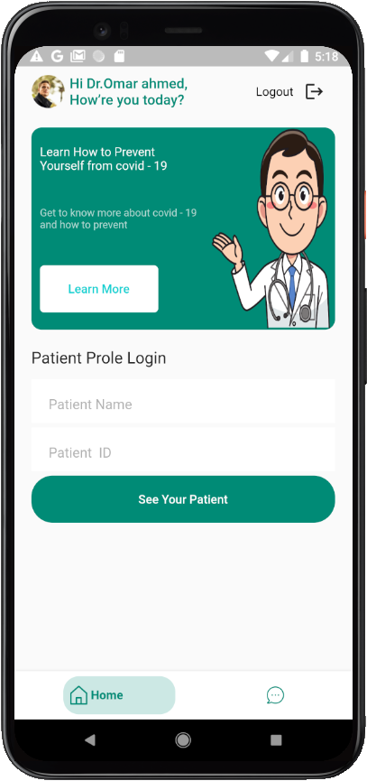
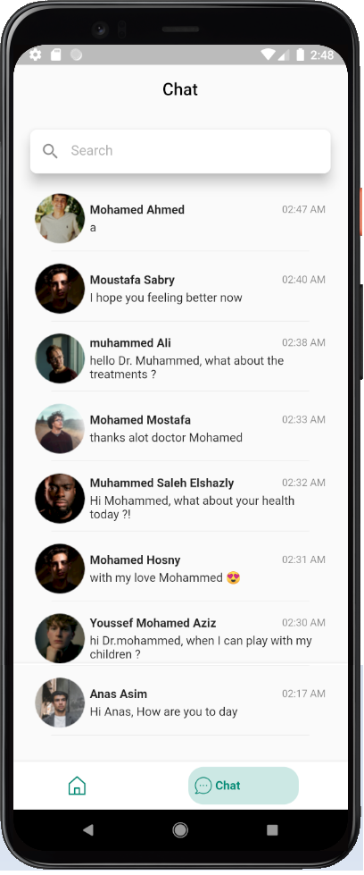

Slide 34
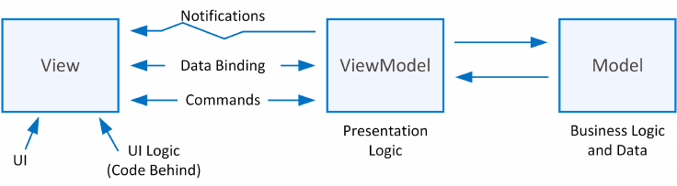
MVVM
Model–View–View model Architectural Pattern

Slide 35
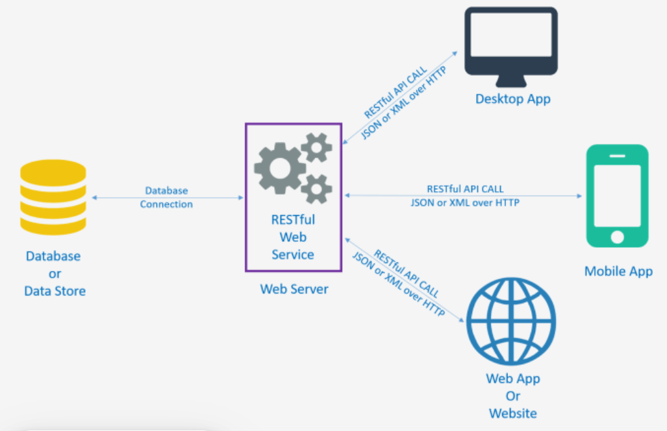
Connected SQL With Mobile App Across RESTful API
Authentications:
Patient Login, Register
Medical Login, Register
Logout
Search For Patient Profile And His Heart Beat And Temperture
Patient Upload His Examinations

Slide 36





Firebase realtime
firebase remote config
Firebase is an application platform that provides many services witch used in the application
Firebase
Cloud Firebase
Firebase authentication

Slide 37
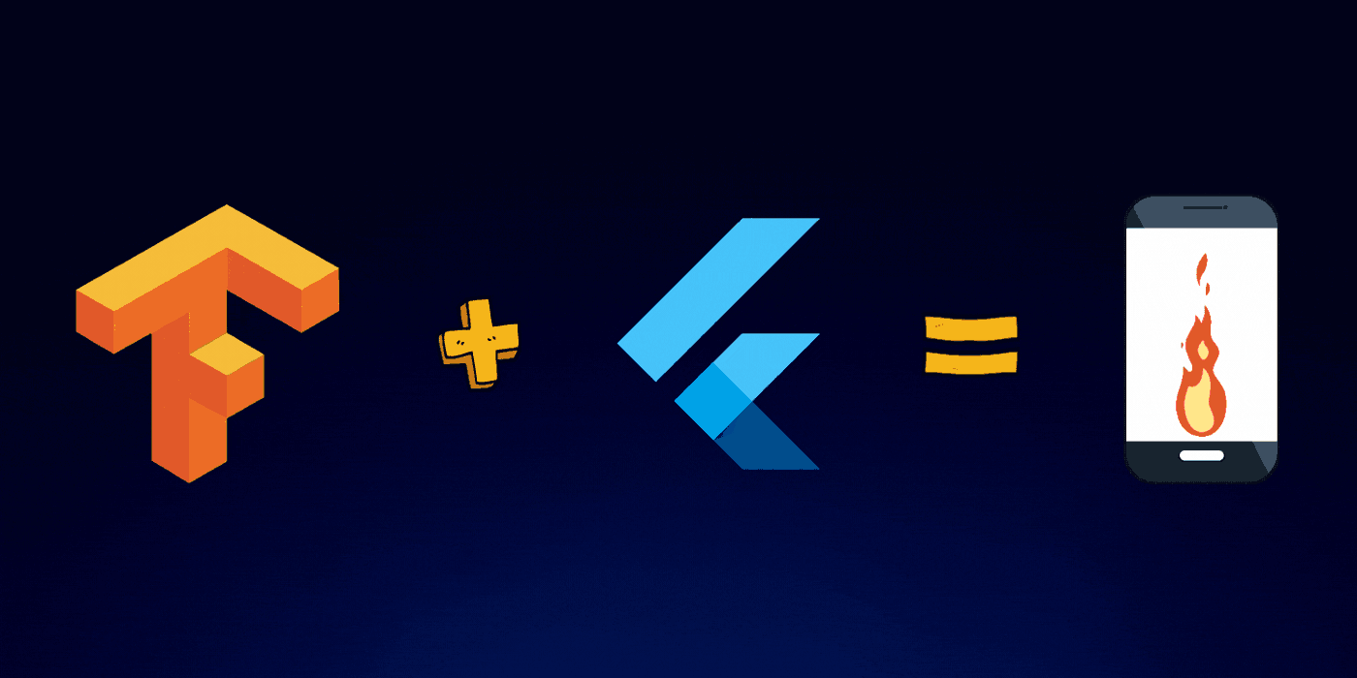
AI TFlite Model Connected With By TensorFlow Lite with Flutter App

Slide 38
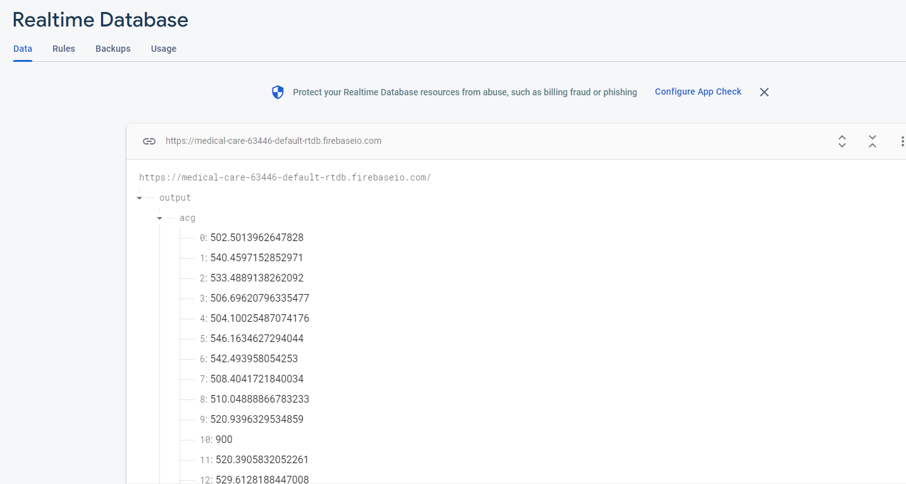
IOT On Firebase Database Realtime

Slide 39
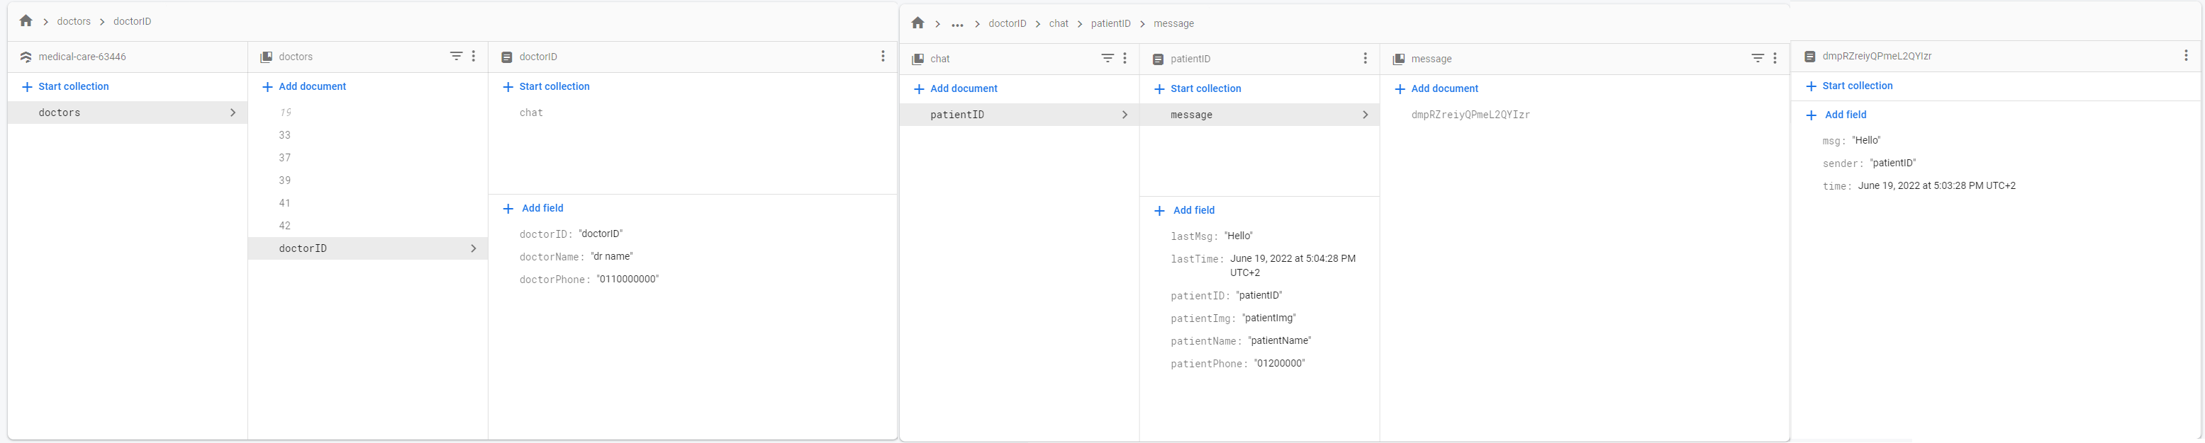
Chat Stream with Firebase Firestore

Slide 40
AI
7

Slide 41
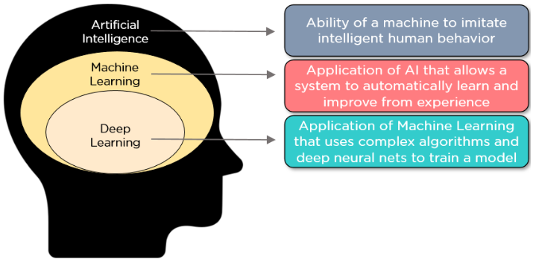
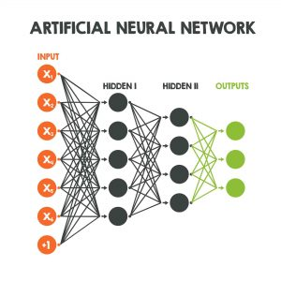
Introduction
Deep Learning
Deep Learning (DL) is a process that simulates human brain function in processing data and creating patterns for making decisions.
Deep learning is a data-driven approach. Having a limited number of samples will have a direct effect on the performance of deep learning based models.

Slide 42
Problem Definition
Many signs and symptoms are non-specific and hence diagnosis is the most challenging job.
We can perform medical image diagnosis using deep learning techniques.
Deep learning (CNNs) mostly require large training, hence their direct application to medical imaging is difficult due to the time and act cost involved in making expertly labeled training datasets.

Slide 43
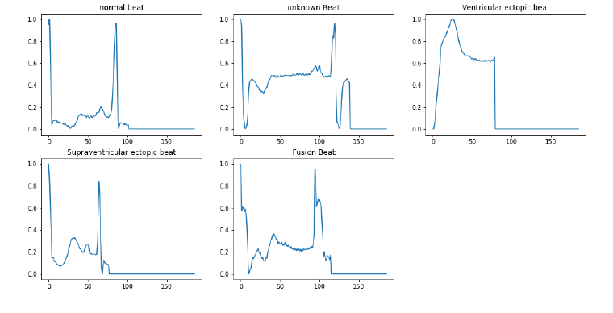
The Proposed Medical Models
Data Description (ECG classification)
Name | ECG classification
Available on : | Open access on Kaggle
Contained Images | 87554 Images
Number of Classes | 4
Number of Image Class: | Unbalanced data sets

Slide 44

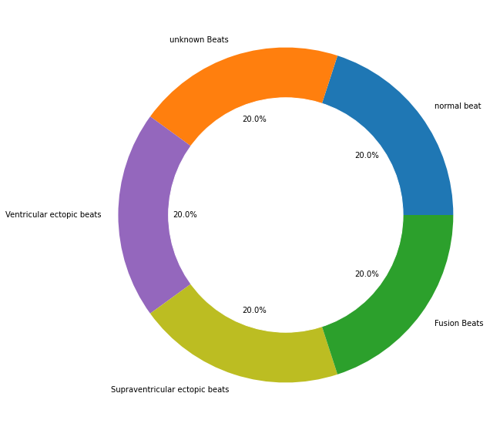
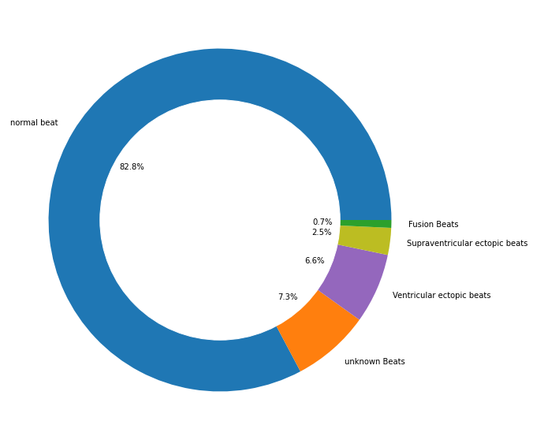
Resampling dataset
AFTER
BEFORE

Slide 45
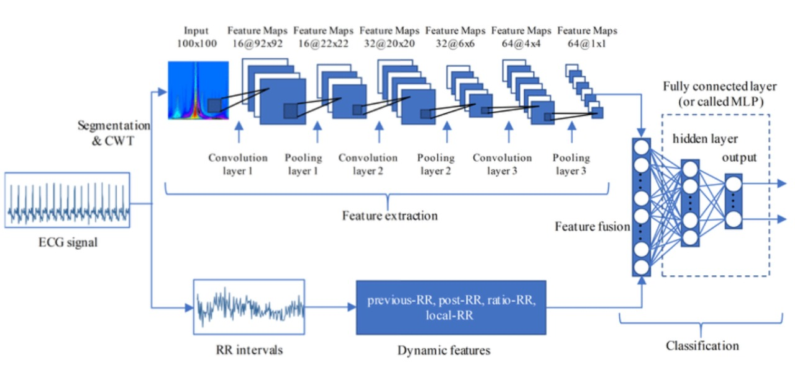
Objective and Motivation
Using Different learning strategies to solve the challenges related to using CNNs on multi-class classification problems with fixed and unevenly distributed sample data

Slide 46
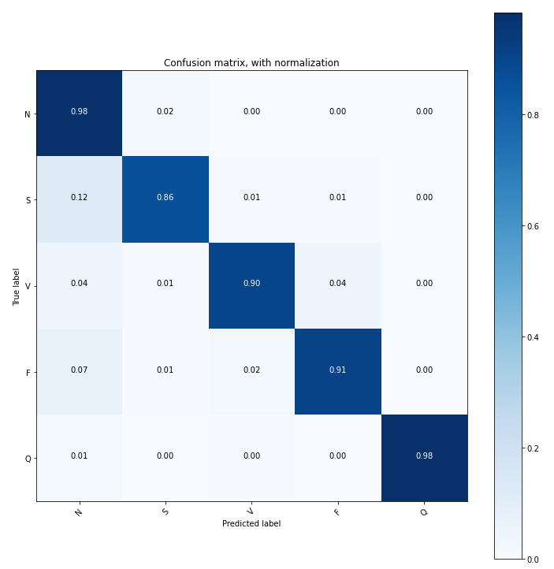
Confusion Matrix

Slide 47
Future Work
8

Slide 48

Future Work
1
Using and improving artificial intelligence technology to help discover diseases more accurately
2
We want to spread our system in all the hospitals to reduce the costs to the patient.
3
And to increase the efficiency of the Healthcare system.

Slide 49
Thanks!

